Slide 1
Hello Gardeners!
Since we cannot be together to plant our garden at school, why not make our own digital gardens at home!
We are going to be using a tool called “Square Foot Gardening” to plan and plant a garden today. First, let’s figure out what that is?

Slide 2
What are some things we need to think about when planting seeds in the garden?

Slide 3
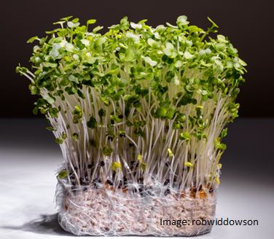
Space is a big thing we need to think about!
Plant your seeds too close and they will have to fight for sunlight, water, and nutrients. This might make them small or sick!
Plant your seeds too far apart and you could be wasting space.
These seeds were planted too close together! Eek!

Slide 4
Gardeners sometimes use a tool called Square Foot Gardening to plant just the right amount of seeds.

Slide 5
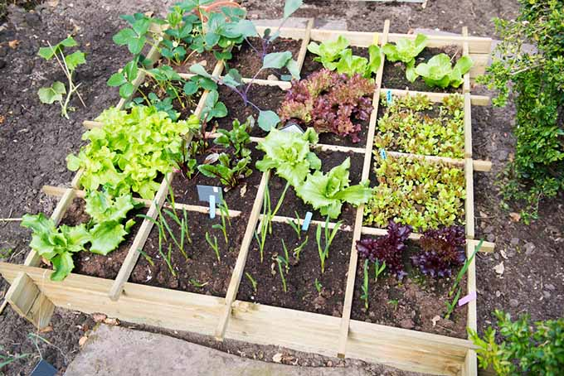
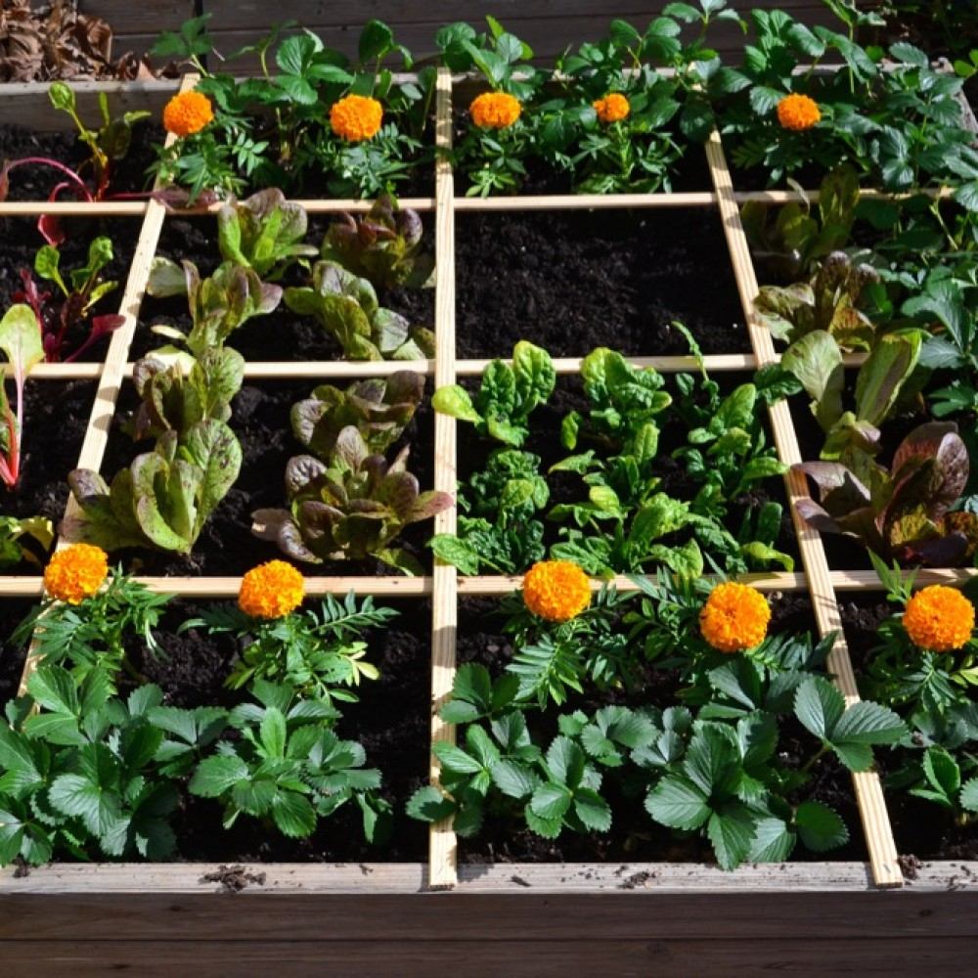
Gardeners divide their beds into perfect 1 foot boxes using wood or string and plant inside of those boxes

Slide 6
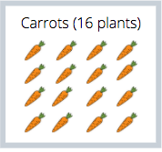
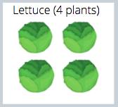
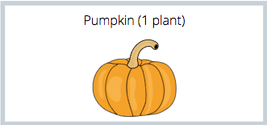
Inside of those 1 foot boxes, you can fit....
16 tiny carrots | Or 4 lettuce plants | Or 1 giant pumpkin-- but it’s so big it takes up two squares!

Slide 7
Let’s get you set up with your own garden bed.
Imagine that this rectangle is your bed

Slide 8
First, we want to divide up our garden plot into those perfect 1 foot squares.
If this rectangle is 6 feet long and 3 feet wide. Can you figure out how many 1 foot squares we can fit?
3 feet
6 feet
Hint: 6x3 =?

Slide 9
16!
3 feet
6 feet

Slide 10
Your Imaginary Garden
Copy and paste the plants you want in your garden from the next few slides! You must have at least one (1) of each plant part in your garden. Have fun and be creative!
Notes:
Click on the plant you want in your garden. Copy & paste it into your imaginary garden above. Resize if you need.

Slide 11
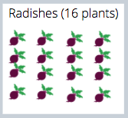
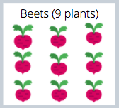
ROOTS
Notes:
Click on the plant you want in your garden. Copy & paste it into your imaginary garden above. Resize if you need.

Slide 12
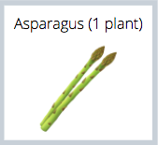
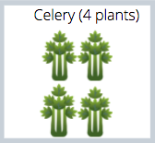
STEMS
Notes:
Click on the plant you want in your garden. Copy & paste it into your imaginary garden above. Resize if you need.

Slide 13
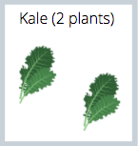
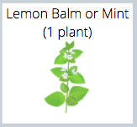
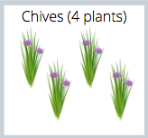
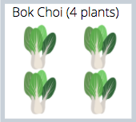
LEAVES
Notes:
Click on the plant you want in your garden. Copy & paste it into your imaginary garden above. Resize if you need.

Slide 14
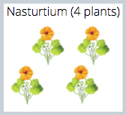
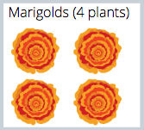
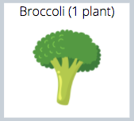
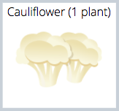
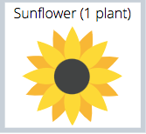
FLOWERS
Notes:
Click on the plant you want in your garden. Copy & paste it into your imaginary garden above. Resize if you need.

Slide 15
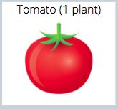
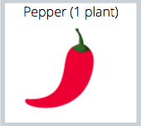
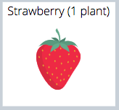
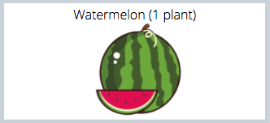
FRUIT
Notes:
Click on the plant you want in your garden. Copy & paste it into your imaginary garden above. Resize if you need.

Slide 16
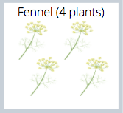
SEEDS
Notes:
Click on the plant you want in your garden. Copy & paste it into your imaginary garden above. Resize if you need.

